Slide 1
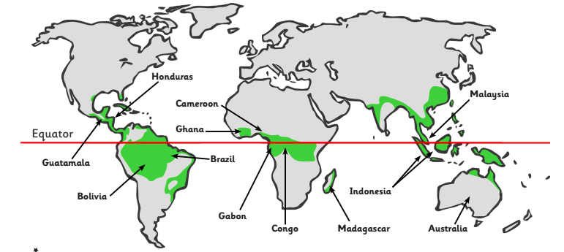
Catton Grove Primary School - History
Historical Skills and Enquiry
Year 3
Topic: Rainforest
Describe where the rainforests are around the word.
Describe what the climate in rainforests is like.
Describe how the rainforests has an impact on modern society.
Describe the layers of the rainforests.
Describe the impact humans have on the rainforest.
Compare what is happening in the rainforest civilisation with what is happening in Britain. Compare aspects of life such as achievements, society, beliefs, and architecture.
Present what you know about the rainforest using a variety of skills (e.g. Geography, English, Maths, Computing, etc)
Use appropriate vocabulary to communicate about the rainforest.
What should I already know?
The weather is humid and it often rains in a rainforest.
Animals, plants and insects live in the rainforest.
There is more than one rainforest.
The Amazon Rainforest is the largest rainforest in the world.
Rainforests are in countries close to the equator.
That the equator divides the planet into a Northern Hemisphere and a Southern Hemisphere.
Core Knowledge
The Amazon rainforest is important because it provides home and shelter for many animals and over 40,000 different plant species that are not found elsewhere in the world.
The Amazon Rainforest produces more than 20% of the world’s oxygen.
The rainforest provides palm oil which is in many foods we consume daily such as Skittles and Doritos.
We know about life in the rainforest because of evidence from studies and being able to visit.
The Amazon Rainforest is home to approximately 250,000 Amazon natives and around 170 different languages are spoken.
It is believed there are as many as 50 tribes living in the Amazon rainforest who have never had contact with the outside world.
Sherwood Forest is a Site of Special Scientific Interest, a National Nature Reserve and a Special Area of Conservation.
Sherwood Forest is linked to the legends of Robin Hood.
Around 500,000 people visit Sherwood Forest every year.

Slide 2
People or Places
The Amazon Rainforest: Located in South America and covers 5.5 million square kilometres of land across 9 countries. The Amazon river flows through the Amazon rainforest. It is at least 55 million years old.
Sherwood Forest: Located in Nottinghamshire, UK and covers 4 square kilometres. The Rivers Idle, Maun, Meden and Poulter flow through Sherwood Forest before joining the River Trent.
Scientific Vocabulary
The Amazon Rainforest: It is 55 million years old and located in South America across 9 countries.
Sherwood Forest: 12000 years old located in Nottinghamshire, UK.
Equator: An imaginary line around the middle of a planet. It is halfway between the North Pole and the South Pole, at 0 degrees latitude. An equator divides the planet into a Northern Hemisphere and a Southern Hemisphere.
Climate: The average measurements of temperature, wind, humidity, snow, and rain in a place over the course of years. Climate is like the weather, but over a long time.
Forest floor Layer: First layer of the rainforest. This layer gets almost no sunlight.
Understorey Layer: Second layer of the rainforest. Many insects live here.
Canopy Layer: Third layer of a rainforest. This layer gets the most rain and sunlight.
Emergent Layer: Fourth layer of the rainforest. Trees in this layer can be as tall as 60cm.
Europe: is a continent where we live.
Habitat: is a place that an animal lives. It provides the animal with food, water and shelter.
Diet: The food and drink that a person or animal usually has.

